Slide 1
Big Data - Lecture 13
Map Reduce

Slide 2
“If you can't explain it to a six year old, you don't understand it yourself.”
― Albert Einstein

Slide 3
Get the simplest form of your application architecture working first.

Slide 4
What are the constraints of your hardware?

Slide 5
Core Motivation
Bring the processing to the data
Historically programs have retrieved data from databases and then perform computations on a separate server.
This is OK for small amounts of data, but not the scale we see today in many datasets.
Assumes you can perform most of your computations in parallel.
Map-Reduce is just a programming model that allows for parallelization.
Map-Reduce frameworks do all the heavy lifting on running your code across clusters of servers and ensuring it completes (i.e. handling failure).
Original work came from Google: http://www.youtube.com/watch?v=NXCIItzkn3E

Slide 6
Clusters -> Map-Reduce
The rise of aggregate-oriented databases is in large part due to the growth of clusters.
Clusters don’t just change the rules for data storage— they also change the rules for computation. If you store lots of data on a cluster, processing that data efficiently means you have to think differently about how you organize your processing.
When you have a cluster, there is good news immediately— you have lots of machines to spread the computation over.
However, you also still need to try to reduce the amount of data that needs to be transferred across the network by doing as much processing as you can on the same node as the data it needs.
The map-reduce pattern (a form of Scatter-Gather) is a way to organize processing in such a way as to take advantage of multiple machines on a cluster while keeping as much processing and the data it needs together on the same machine.

Slide 7
Map-Reduce definition
MapReduce is a programming model for processing large data sets with a parallel, distributed algorithm on a cluster.^{[1]}
A MapReduce program is composed of a Map() procedure that performs filtering and sorting and a
Reduce() procedure that performs a summary operation.
The "MapReduce System" (also called "infrastructure" or "framework") orchestrates by marshalling the distributed servers, running the various tasks in parallel, managing all communications and data transfers between the various parts of the system, and providing for redundancy and fault tolerance.

Slide 8
Map
Goal of map function is to produce key / value pairs
Each map function is independent of others
Allows them to be safely parallelized
Data is co-located with processing
Can be any arbitrarily complex function (not just selection)
Map stage can be all you want to do (e.g. transformation)

Slide 9
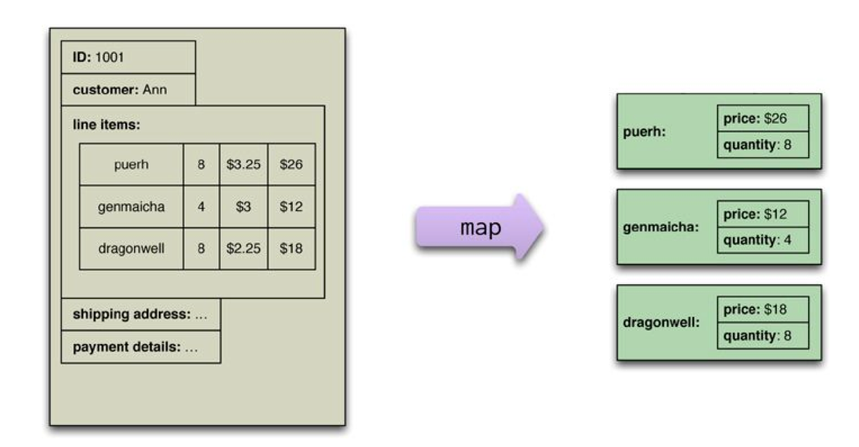
Map Example
A map function reads records and emits key/value pairs.

Slide 10
Reduce
While the map function is limited to working only on data from a single aggregate, the reduce function can use all values emitted for a single key.
The map-reduce framework arranges for the map tasks to be run on the correct nodes to process all the documents and for data to be moved to the reduce function.
The framework collects all the values for a single pair and calls the reduce function once with the key and the collection of all the values for that key.

Slide 11
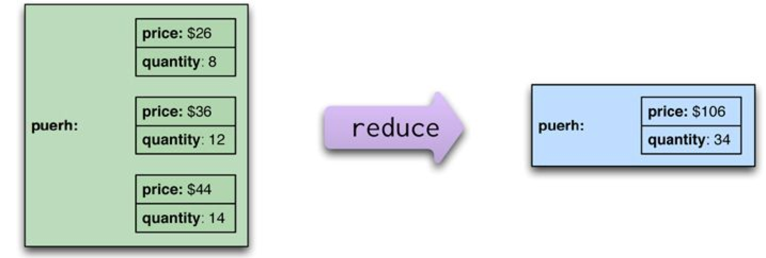
Reduce Example
A reduce function takes several key-value pairs with the same key and aggregates them into one.

Slide 12
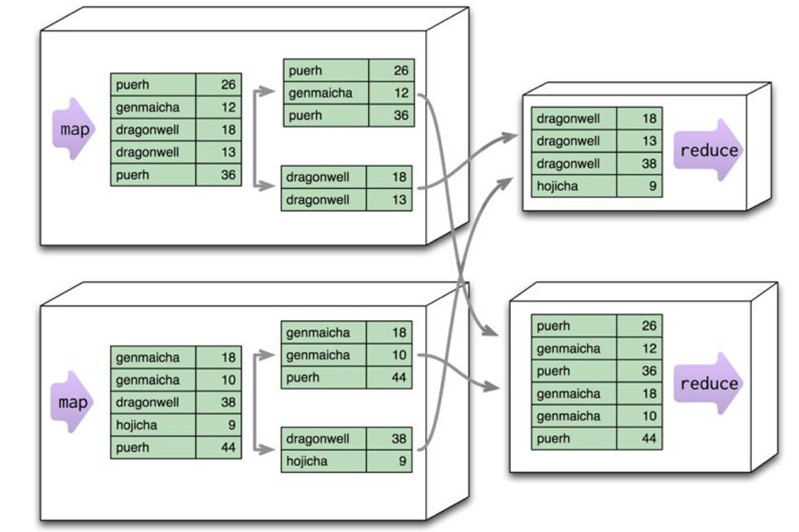
Partitioning
Partitioning (aka ‘Shuffling’) allows reduce functions to run in parallel on different keys.

Slide 13
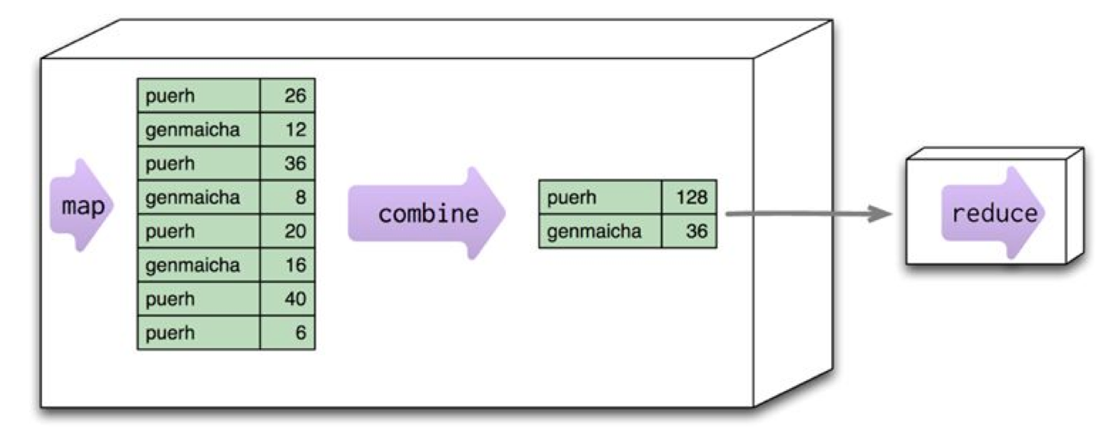
Combining Reducers
Combining reduces data before sending it across the network.
The reduce function needs a special shape for this to work. Its output must match its input - a combinable reducer.

Slide 14
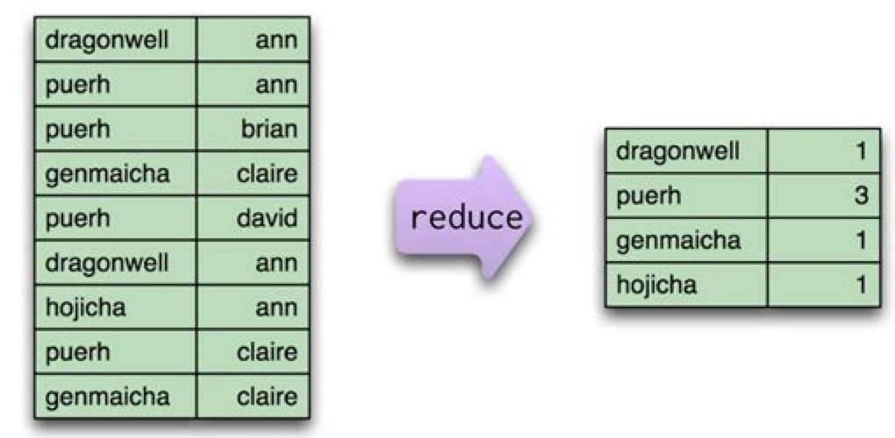
Not all are combinable
This reduce function, which counts how many unique customers order a particular tea, is NOT combinable. Input != Output.

Slide 15
Composing Map-Reduce
It is a way of thinking about concurrent processing that trades off flexibility in how you structure your computation for a relatively straightforward model for parallelization.
Within a map task, you can only operate on a single aggregate.
You have to structure your calculations around operations that fit in well with the notion of a reduce operation.
Example: Averages:
An important property of averages is that they are not composable - that is, if I take two groups of orders, I can’t combine their averages alone. Instead, I need to take total amount and the count of orders from each group, combine those, and then calculate the average from the combined sum and count.

Slide 16
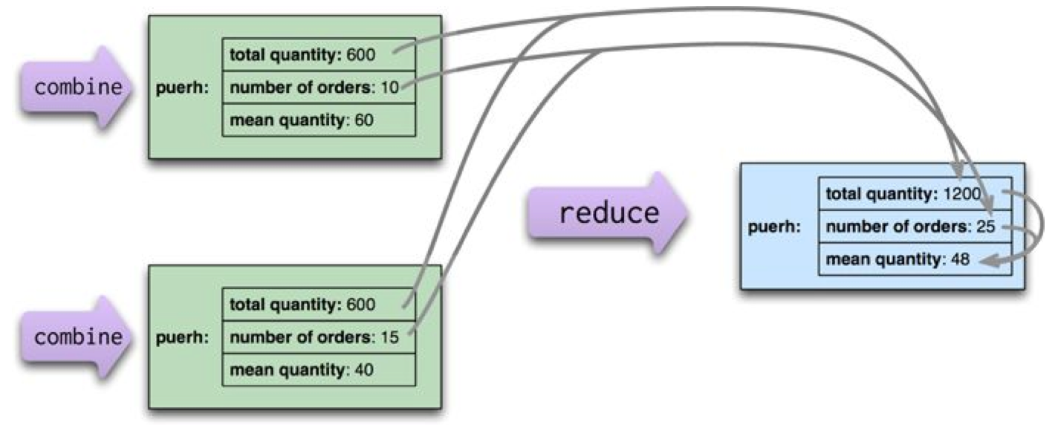
What can be combined?
When calculating averages, the sum and count can be combined in the reduce calculation,but the average must be calculated from the combined sum & count.

Slide 17
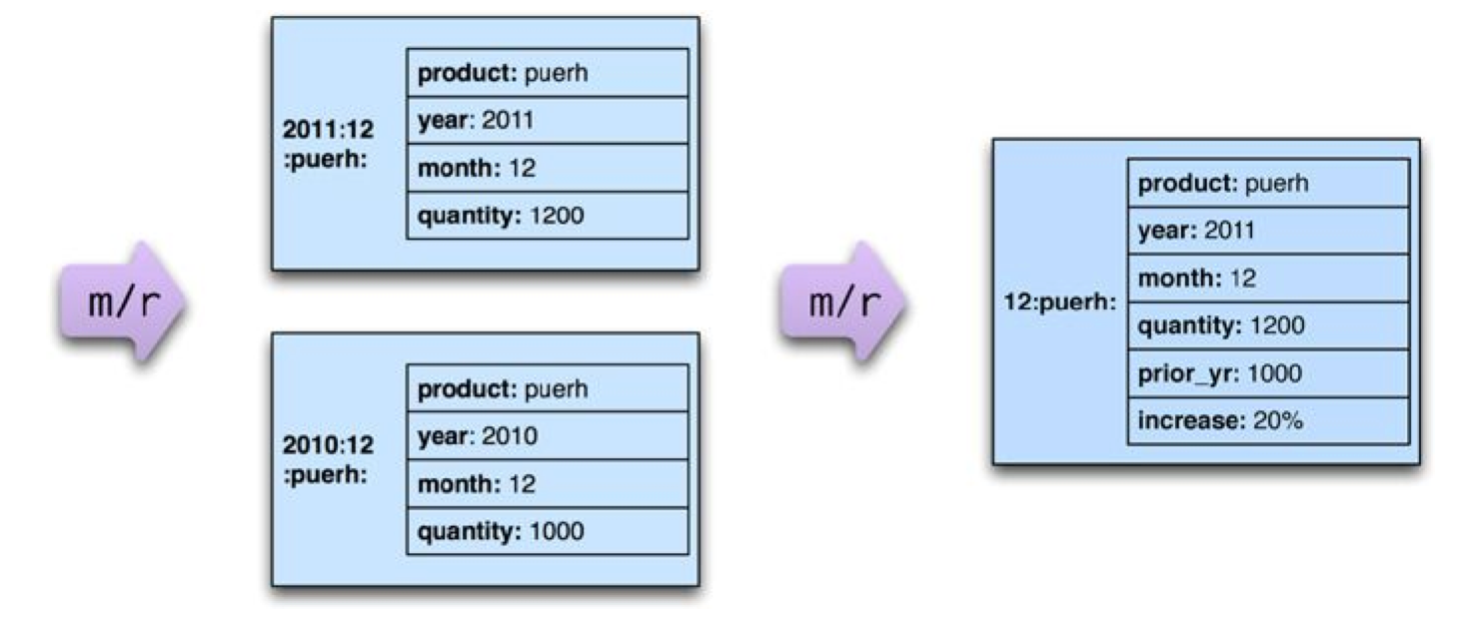
Two Stage Map-Reduce
As map-reduce calculations get more complex, it’s useful to break them down into stages using a pipes-and-filters approach, with the the output of one stage serving as input to the next, like the pipelines in UNIX.

Slide 18
Why?
Decomposing this report into multiple map-reduce steps makes it easier to write.
Like many transformation examples, once you’ve found a transformation framework that makes it easy to compose steps, it’s easier to compose many small steps together than try to cram heaps of logic into a single step.
Another advantage is that the intermediate output may be useful for different outputs too, so you can get some reuse.
Reduce operations are particularly valuable to save since they often represent the heaviest amount of data access.

Slide 19
Key Points
Map-reduce is a batch pattern to allow computations to be parallelized over a cluster.
The map task reads data from an aggregate and boils it down to relevant key-value pairs. Maps only read a single record at a time and can thus be parallelized and run on the node that stores the record.
Reduce tasks take many values for a single key output from map tasks and summarize them into a single output.
Reducers that have the same form for input and output can be combined into pipelines. This improves parallelism and reduces the amount of data to be transferred.
Map-reduce operations can be composed into pipelines where the output of one reduce is the input to another operation’s map.
If the result of a map-reduce computation is widely used, it can be stored as a materialized view for reuse.
Materialized views can be updated through incremental map-reduce operations that only compute changes to the view instead of recomputing everything from scratch.

Slide 20

Hadoop
An open-source distributed file system + map-reduce framework.
Created by Doug Cutting (named after his son’s toy elephant)
Resources
Apache project - http://hadoop.apache.org/
MapR - http://www.mapr.com/
https://www.youtube.com/watch?v=HFplUBeBhcM
Cloudera - http://www.cloudera.com
http://www.cloudera.com/content/cloudera/en/why-cloudera/hadoop-and-big-data.html
Pig - http://pig.apache.org/ (script lanaguage producing MapReduce tasks)
Hive - https://hive.apache.org/ (subset of SQL on dist. data)
Doug Cutting: https://ctovision.com/deep-insights-future-hadoop-cutting-cloudera/

Slide 21
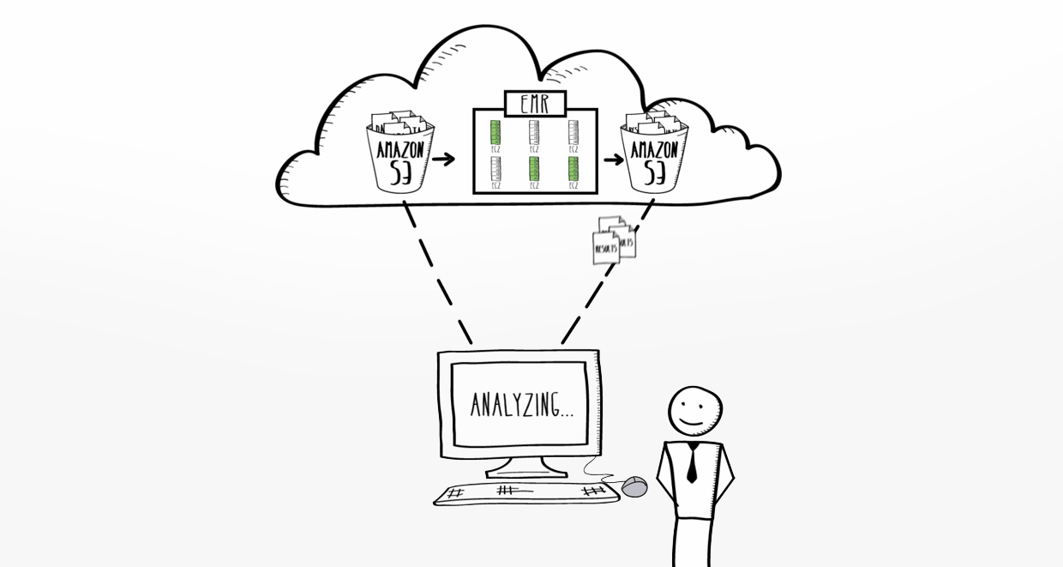
Amazon EMR
Map-Reduce as a service on AWS… (hard to debug)
http://aws.amazon.com/elasticmapreduce/

Slide 22
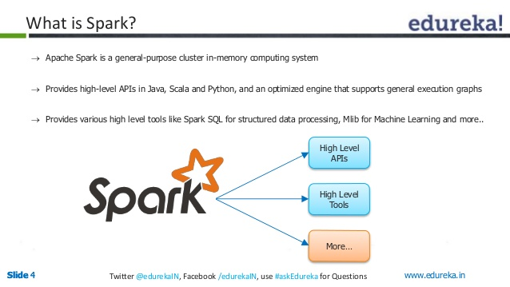
Spark (not MapReduce)
newer framework for processing cluster in-memory data…
http://spark.apache.org/
popularity because of increased perf. - quicker answers to questions

